Slide 1
Sex Chromosomes

Slide 2
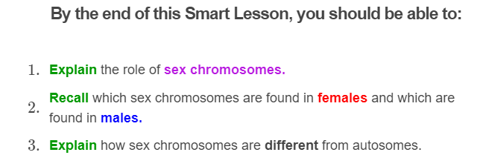
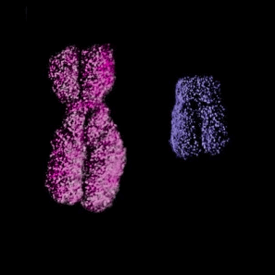

Slide 3
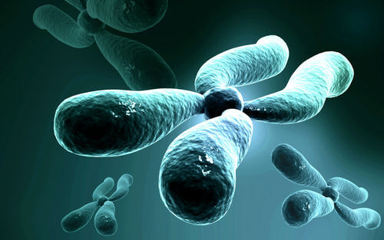
Remember, there are 46 chromosomes in your cells that can be sorted into 23 pairs.
So far we have assumed that all 23 pairs are homologous, meaning their chromosomes are the same length and have the same genes.
However, one of the pairs is a little different from the others.

Slide 4
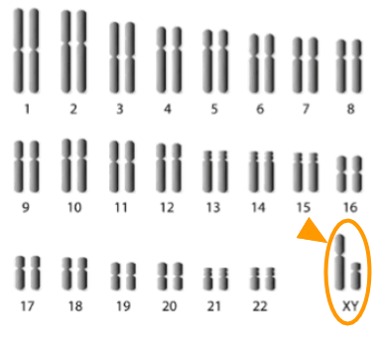
This picture shows the 46 chromosomes in a human cell.
The first 22 pairs are numbered. These are your autosomes.
Then there are the XX and XY pairs. These are your sex chromosomes.

Slide 5

The sex chromosomes determine your born sex.
Essentially every individual has either an XX or an XY pair.
Occasionally, people are born with an additional sex chromosome or with only one sex chromosome.
If you have two X chromosomes (XX) you are born female. If you have one X and one Y chromosome (XY) you are born male.

Slide 6
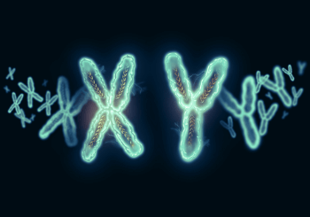
Autosomes are always homologous, but the sex chromosomes are only homologous in females.
This is because the Y chromosome is smaller than the X and is missing some genes.
So the X and Y sex chromosomes in males are not homologous.

Slide 7
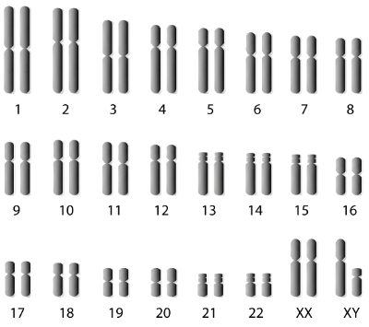
Men and women have the same number of chromosomes, but different numbers of homologous pairs.
Females have 23 homologous pairs, one of which contains the sex chromosomes (XX).
Males have 22 homologous pairs, plus 1 pair of non-homologous sex chromosomes (XY).

Slide 8


